Slide 1
Grow more chat app
( It is a cloud based chatting application like such as what’s app, Instagram. )
TEAM MEMBERS :
M.Veeramanikandan
S.Pon Prakash
S.Hari Vignesh
K.Sharin
V.Kavin
B.Vishnu Kumar

Slide 2
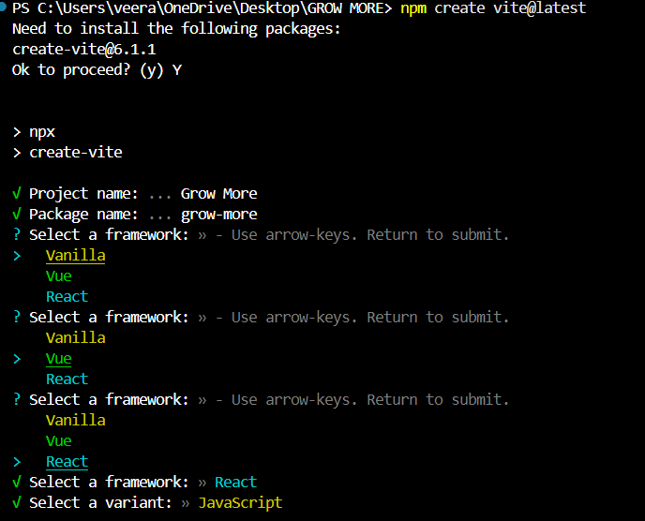
The command npm create vite@latest is used to create a
New project using vite a fast frontend development build
Tool, with the latest available version.
WHAT HAPPENS WHEN YOU RUN THIS COMMAND ?
Project setup: it initialize a new project using vite‘
template-based starter files.
Interactive CLI: You are usually prompted to:
Enter the project name.
Choose a framework (e.g., Vanilla, React, Vue, Svelte, etc.).
Select the preferred variant (e.g., JavaScript or TypeScript)
Project Files: After completing the setup, Vite scaffolds a basic project directory structure and configuration files.
Installation Guidance: The command will often advise you on the next steps, such as navigating into the project folder (cd your-project-name) and installing dependencies (npm install).

Slide 3
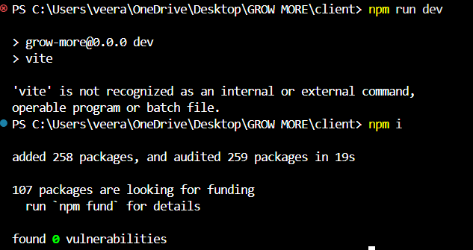
The command npm run dev is commonly used in web development projects built with JavaScript frameworks like Node.js, React, Vue.js, or others. Here's what it means and does:
WHAT HAPPEN WHEN YOU RUN npm run dev ?
When you execute npm run dev, npm checks the package.json file for a script named dev and executes the corresponding command.
For instance:
If you're working on a Next.js project, npm run dev starts the Next.js development server.
In a Vue.js project, it could start the Vue development server (using vite or vue-cli).
In a Node.js backend project, it might start nodemon, which reloads the server upon changes.

Slide 4
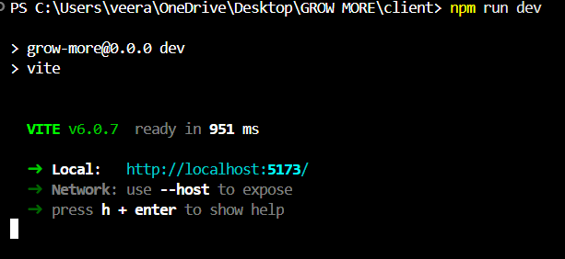
COMMON USE CASE
In most projects:
The development server lets you see changes live as you work on your project, providing instant feedback.
It often runs on a specific local port (e.g., http://localhost:3000 or http://localhost:5173).
You can inspect the package.json to see what the dev script does exactly for your project. If there’s no dev script in the package.json, running npm run dev will result in an error.

Slide 5
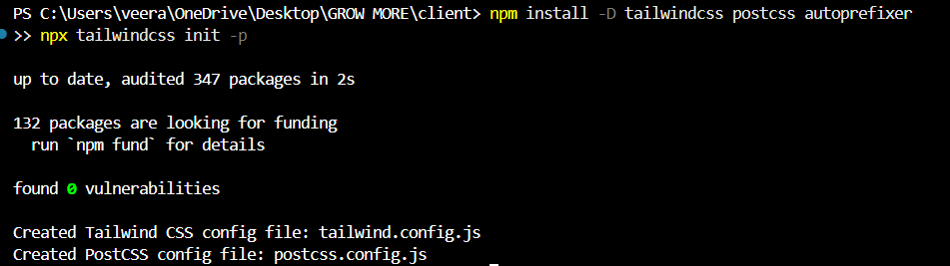
This command sets up Tailwind CSS in a development environment with PostCSS and Autoprefixer, and initializes the necessary configuration files.
What Happens After This Command?
Installs the necessary packages (tailwindcss, postcss, and autoprefixer) as dev dependencies.
Creates:
A tailwind.config.js file for Tailwind CSS customization.
A postcss.config.js file to set up PostCSS and its plugins.

Slide 6
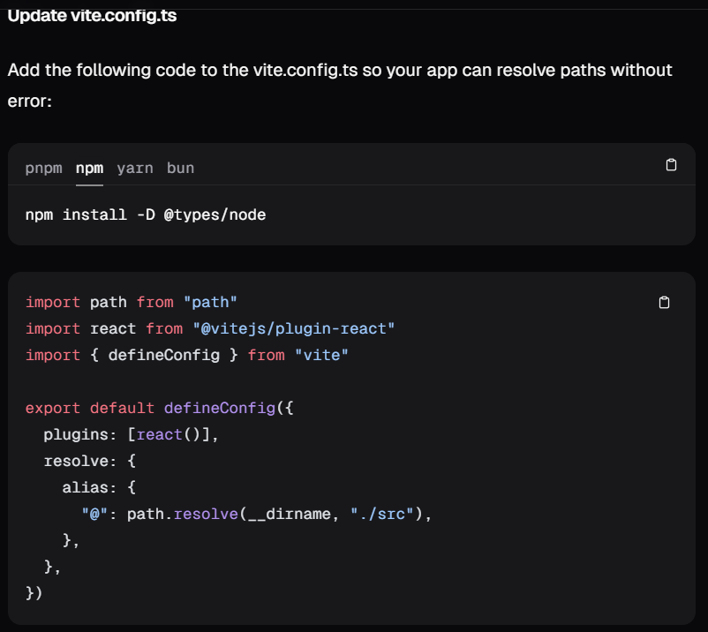
The command npm install -d @types/node is used to install TypeScript type definitions for Node.js.
npm install: This is the command used to install packages in a Node.js project.
-d: This flag is shorthand for --save-dev, meaning the package will be installed as a development dependency. Development dependencies are used during development and testing but aren't included in the production build.
@types/node: This refers to the package that provides TypeScript type definitions for Node.js. Type definitions help TypeScript understand the types of various built-in Node.js modules, like fs, path, and http, so you can get proper type checking and autocompletion when writing your code.

Slide 7
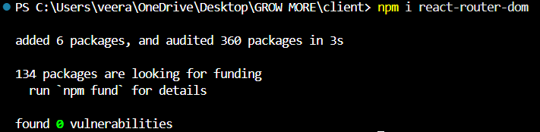
The command npm i react-router-dom is used to install the react-router-dom package in a React project.
npm i: This is shorthand for npm install, which installs a package in your Node.js project. If the package isn't already in the node_modules folder, it will download and install it.
react-router-dom: This is the package that provides routing functionality for React applications that run in the browser (client-side). It helps you manage navigation, rendering of different components based on URL changes, and enables features like navigating between pages without reloading the entire app.

Slide 8
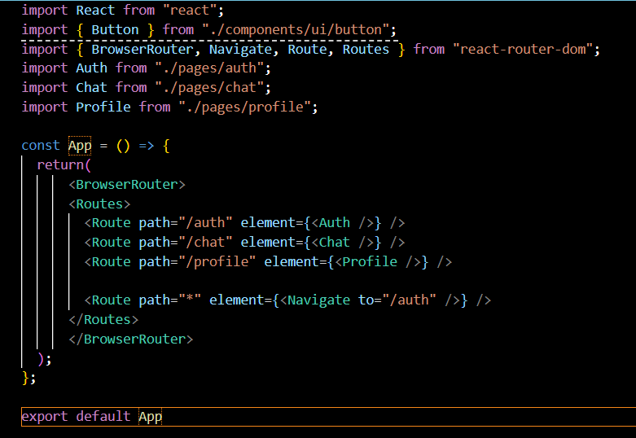
The code const app = () => {} defines a JavaScript arrow function and assigns it to the constant variable app
const: Declares the app variable as a constant, meaning its value cannot be reassigned.
app: The name of the variable holding the function.
= () => {}: Defines an arrow function (a shorthand syntax for writing functions in JavaScript).

Slide 9
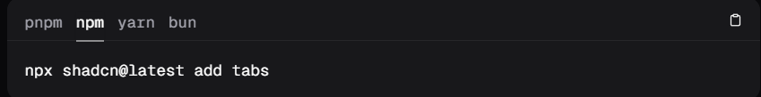
The command npx shadcn@latest add tabs is used to install and add a UI component or feature (in this case, tabs) from ShadCN to your project.
npx: This is a package runner that comes with npm (Node
Package Manager). It allows you to run a package without needing to install it globally. npx will fetch the package from the npm registry and run it immediately.
shadcn@latest: This refers to the ShadCN package, specifically the latest version. ShadCN is a toolset that helps you add reusable, customizable UI components to your React project. The @latest part ensures that you are using the most recent version of the package.
add tabs: This tells ShadCN to add the tabs component to your project. ShadCN offers a variety of UI components, and using add tabs will automatically install and configure a tabs component (with necessary styles and dependencies) into your project.

Slide 10
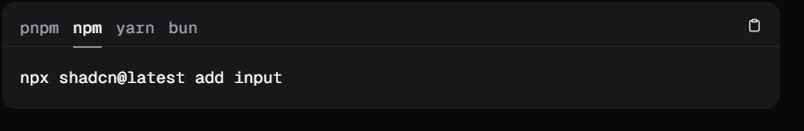
The command npx shadcn@latest add input is used to quickly install and add an input component from the ShadCN UI component library to your project.
npx: This tool allows you to run packages without globally installing them. It fetches and runs the specified package directly from the npm registry.
shadcn@latest: This specifies the ShadCN library and ensures you're using the latest version of it. ShadCN provides customizable, reusable UI components for React projects.
add input: This tells ShadCN to add the input component to your project. The add command is used to automatically install the necessary files, dependencies, and configurations for that specific component.

Slide 11
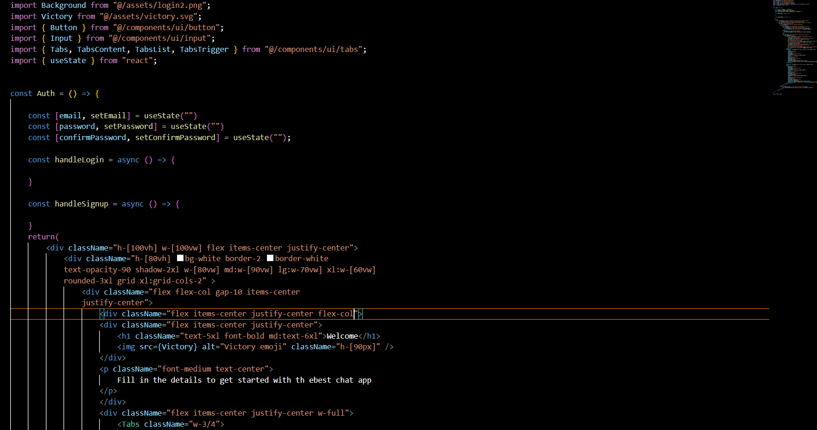
State Management
email, password, confirmPassword: These states hold the user input for login and signup forms.
setUserInfo: This comes from useAppStore to store user details once they are authenticated.
Validation Functions
validateLogin(): Checks if the email and password fields are not empty before allowing login.
validateSignup(): Checks if the email, password, and confirmPassword fields are filled out and if the password and confirmPassword match.
Handlers for Login and Signup
handleLogin():
Validates the input using validateLogin().
Makes a POST request to the LOGIN_ROUTE with the user's email and password.
If login is successful and the user has a profile setup, they are navigated to the /chat route; otherwise, they are sent to the /profile route to complete their profile.
handleSignup():
Validates the input using validateSignup().

Slide 12
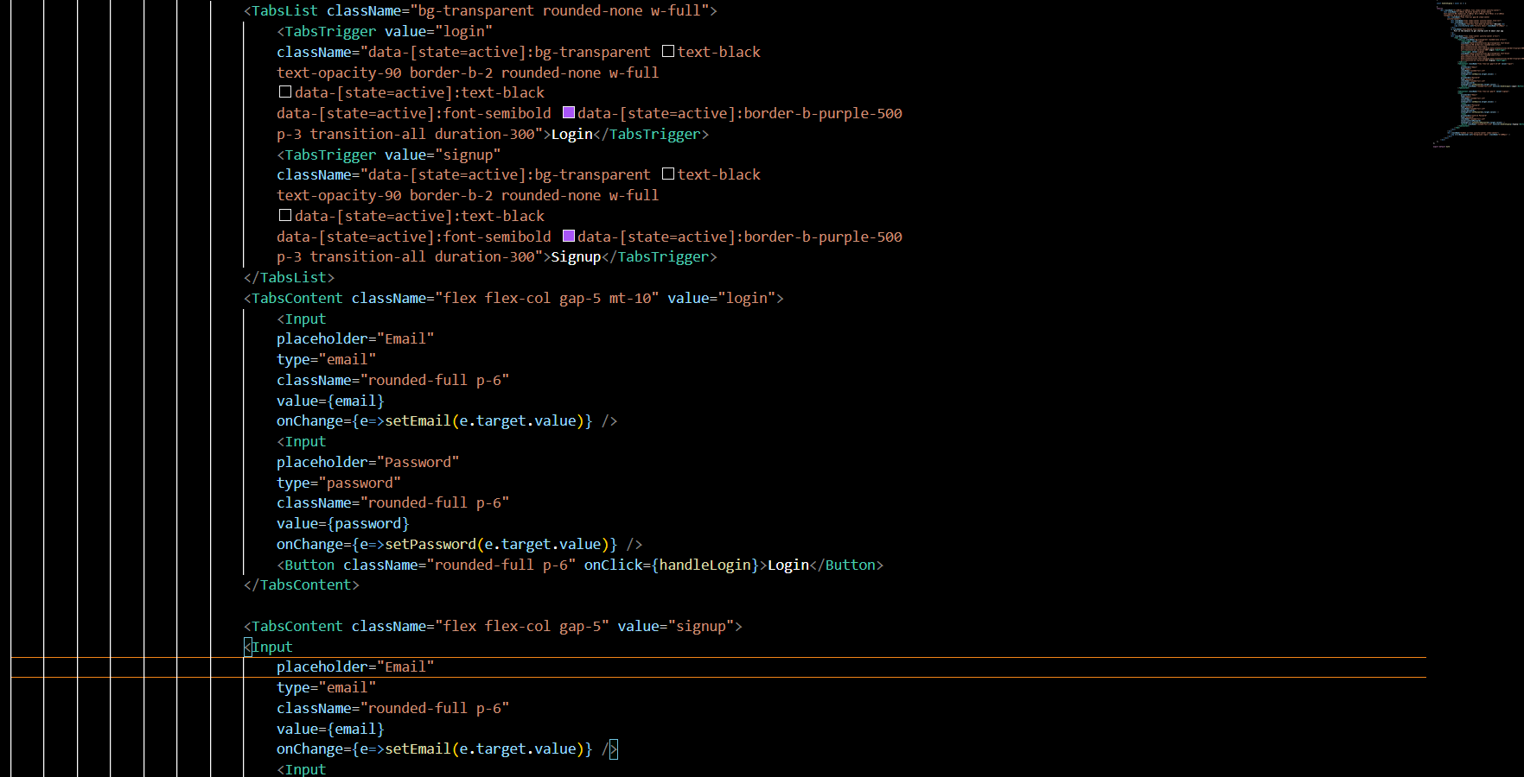
UI Layout
The layout is a flex-based, responsive design with two main sections:
Left Section:
Displays the app’s welcome message with the title "Welcome" and an image (Victory) next to it.
Below the welcome message, a description text gives context to the form.
A Tabs component holds two sections for login and signup, which toggle based on the active tab:
Login Tab:
Input fields for email and password, with a login button.
Signup Tab:
Input fields for email, password, and confirm password, with a signup button.
Right Section:
An image (Background) displayed only on larger screens (hidden on mobile).

Slide 13
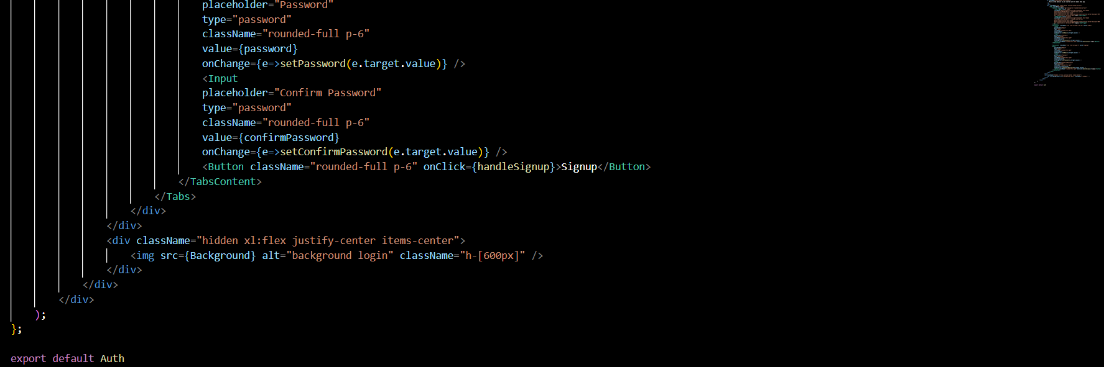
Styling
The component uses a combination of custom Tailwind CSS classes (e.g., h-[100vh], w-[100vw], flex, gap-10, etc.) for responsive, flexible, and consistent layout styling.
The components are styled using Tailwind’s utility-first classes, making the design responsive across different screen sizes (xl, md, etc.).
Tab switching behavior is customized to highlight the active tab (data-[state=active]:bg-transparent, data-[state=active]:font-semibold, etc.).
How It Works
When the user fills out the login or signup form, the handleLogin() or handleSignup() functions are triggered.
These functions validate the input and then make an API request to the appropriate route.
If the request is successful, the user’s data is stored in the global state using setUserInfo, and they are navigated to the appropriate page (either /chat or /profile).
Error Handling
Toast Notifications: The program uses toast.error() to display error messages to users if the input is not valid or the API request fails.

Slide 14
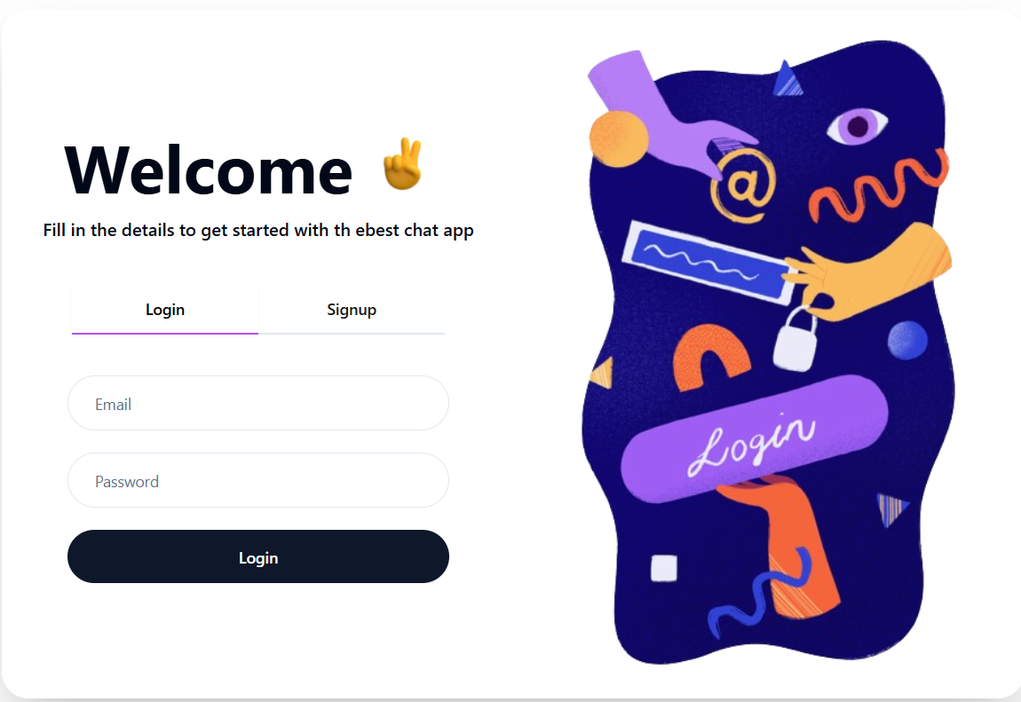
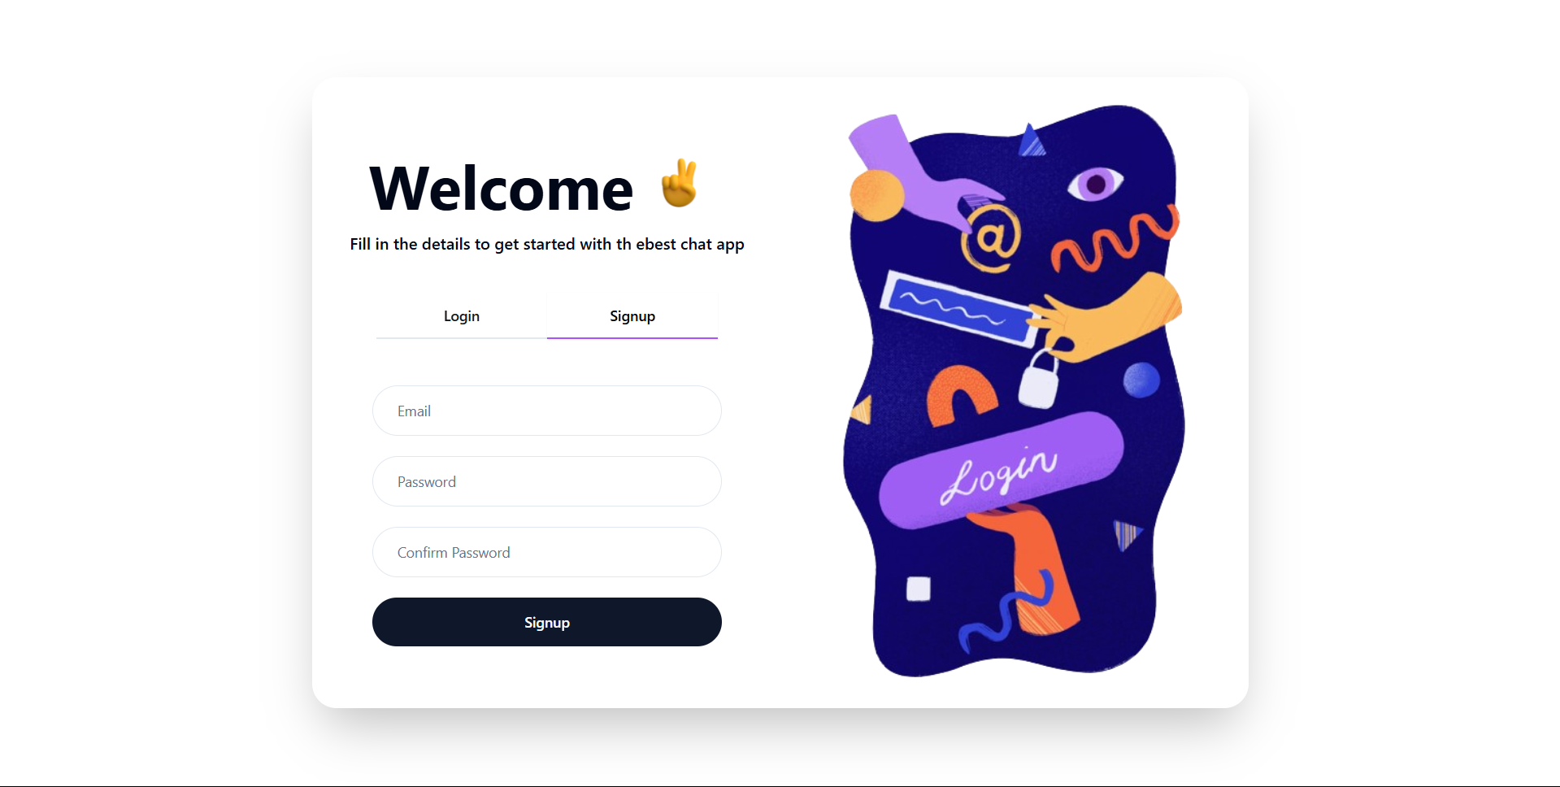

Slide 15
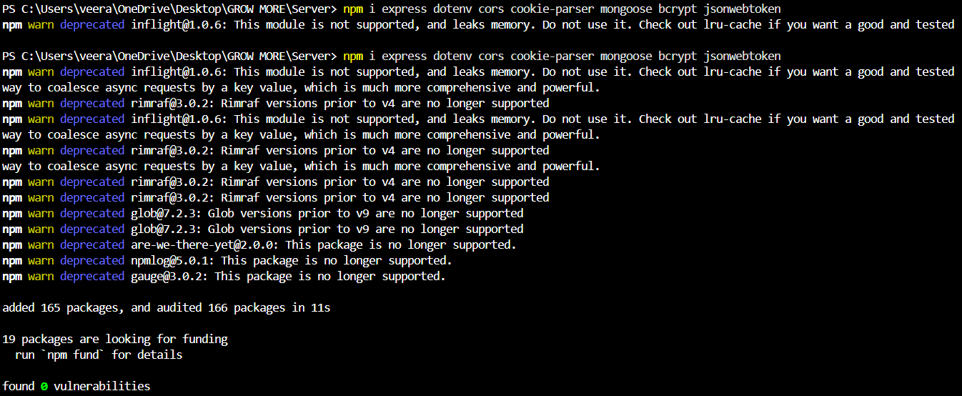
The message npm WARN deprecated is a warning that appears when you run an npm (Node Package Manager) command like npm install, and one or more of the packages you're installing have been marked as deprecated.
Deprecated means that the package you're using is no longer maintained or recommended for use. The package authors might have decided to stop supporting it, or they might have released a new version or alternative that you should use instead.
npm WARN indicates that this is a warning and not an error. The installation or other npm command will usually still complete, but you're being informed that the package you're trying to install is deprecated, and you should look for a newer or alternative version if possible.

Slide 16
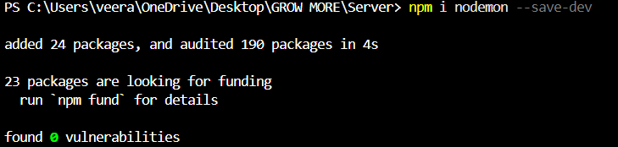
The command npm i modeon is used to install a package called modeon in your Node.js project.
npm i: This is shorthand for npm install, which installs the specified package into your project.
nodemon: This is the name of the package you want to install.

Slide 17
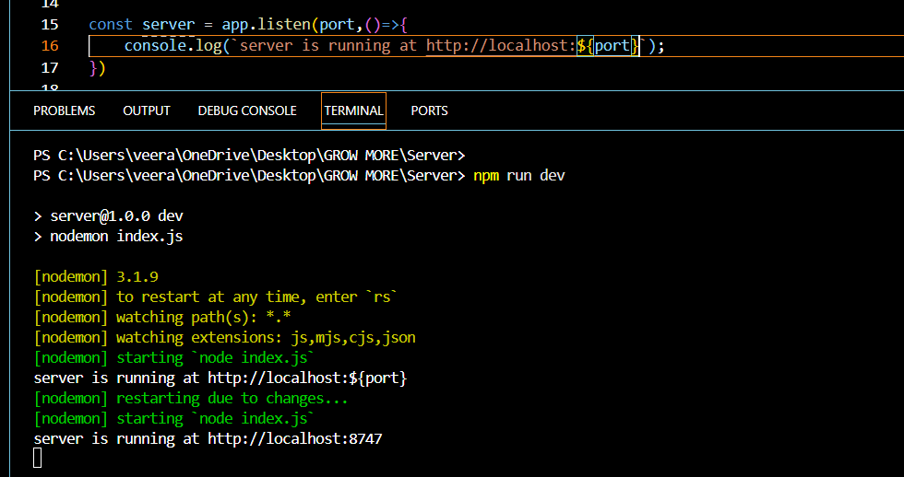
The command npm run dev is used to run a custom script defined in your project's package.json file. It's typically used to start the development server or to run other tasks related to the development environment.
npm: Node Package Manager, used to manage and run scripts, install packages, and handle dependencies in a Node.js project.
run: Tells npm to execute a script defined in the scripts section of the package.json file.
dev: The name of the script you want to run. The dev script is commonly used to start the development environment (such as a local server or watcher) for a project.

Slide 18
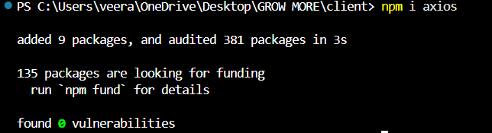
The command npm i axios is used to install the Axios library into your Node.js project.
npm: This stands for Node Package Manager, which is used to install and manage packages in your project.
i: This is shorthand for install, which tells npm to download and install the specified package.
axios: This is the name of the package you're installing. Axios is a promise-based HTTP client that is often used in JavaScript and Node.js to make HTTP requests (such as GET, POST, PUT, DELETE) to external APIs or servers.

Slide 19
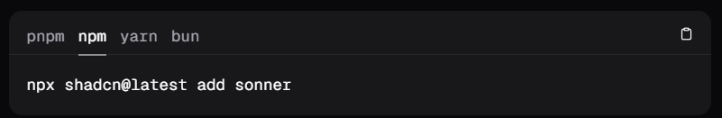
The command npx shadcn@latest add sonner is used to install and add the Sonner component to your project using the ShadCN UI component library.
npx: This is a command-line tool that comes with npm (Node Package Manager). It allows you to run packages directly without installing them globally. In this case, it runs the shadcn package.
shadcn@latest: This refers to the ShadCN library, and the @latest ensures you are using the most recent version of it.
add sonner: This part of the command tells ShadCN to add the Sonner component to your project. "Sonner" could be a specific UI component (like a notification or alert component) provided by ShadCN.

Slide 20
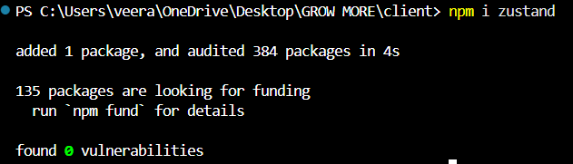
The command npm i zustand is used to install the Zustand library into your project.
npm: Node Package Manager, used to manage dependencies and packages in your project.
i: This is shorthand for install, which tells npm to download and install the specified package.
zustand: Zustand is the name of the package being installed. Zustand is a small, fast, and scalable state management library for React.

Slide 21
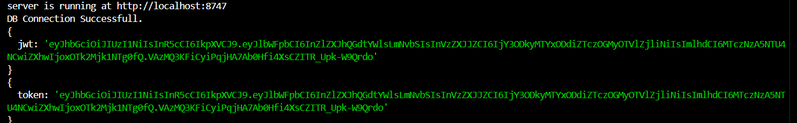
In general, JWT is used to create secure tokens that can represent claims between two parties. It’s commonly used for handling authentication and authorization in web applications, where a server issues a token upon successful login, and that token can be used for subsequent API requests to validate the user.
Token generally refers to a secure string used for authentication or authorization.
It could refer to API tokens used to authenticate requests or JWT tokens used for managing user sessions.
If you encounter token as a command, it might refer to tools for managing tokens or authenticating with a specific service (e.g., GitHub, Auth0).
Tokens are commonly included in HTTP requests for API calls, often as part of the Authorization header.

Slide 22
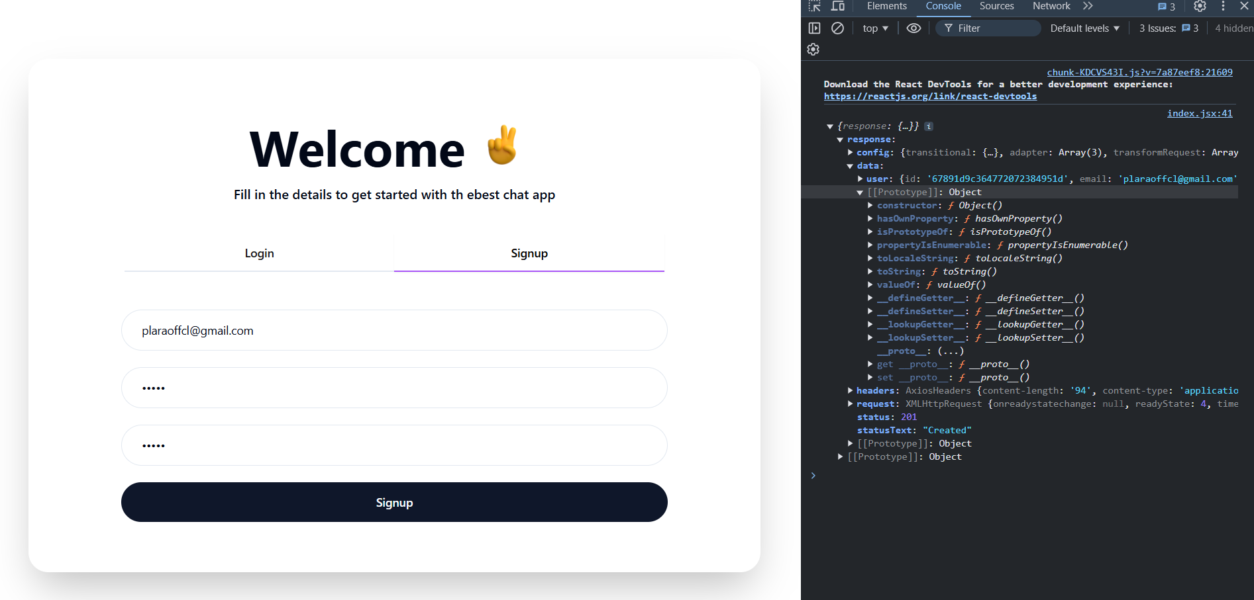

Slide 23
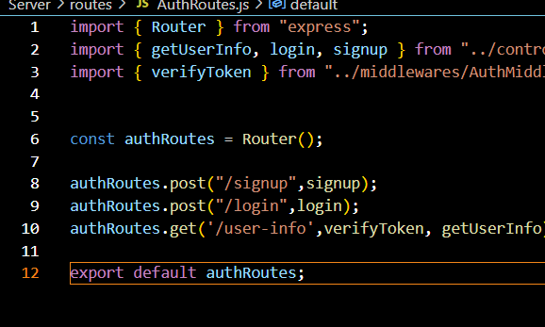
Router: This is imported from express to define route handlers. It’s used to create a modular set of routes for handling authentication.
Controller functions (getUserInfo, login, signup): These are imported from ../controllers/AuthController.js. They define the actual logic for handling authentication-related requests (signup, login, and fetching user info).
verifyToken middleware: This is imported from ../middlewares/AuthMiddleware.js. It's used to ensure that the user is authenticated before accessing certain routes (like getting user info). This middleware will check if the request contains a valid JWT token.

Slide 24
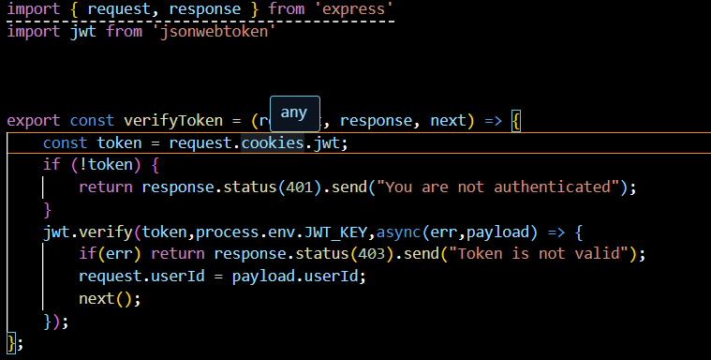
Router: This is imported from express to define route handlers. It’s used to create a modular set of routes for handling authentication.
Controller functions (getUserInfo, login, signup): These are imported from ../controllers/AuthController.js. They define the actual logic for handling authentication-related requests (signup, login, and fetching user info).
verifyToken middleware: This is imported from ../middlewares/AuthMiddleware.js. It's used to ensure that the user is authenticated before accessing certain routes (like getting user info). This middleware will check if the request contains a valid JWT token.

Slide 25
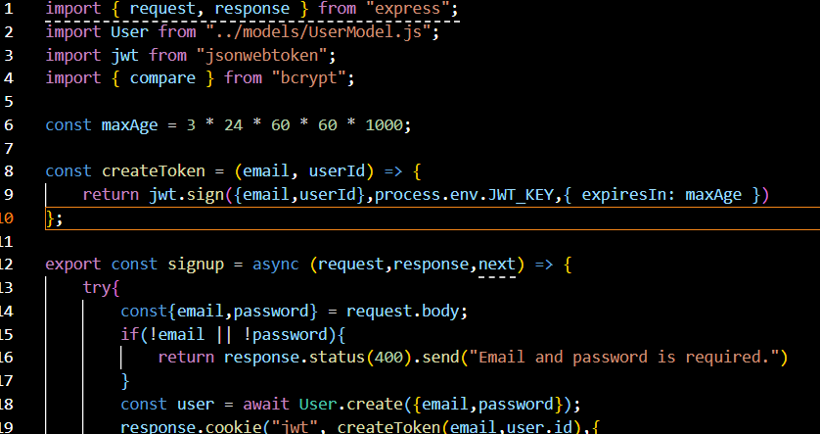
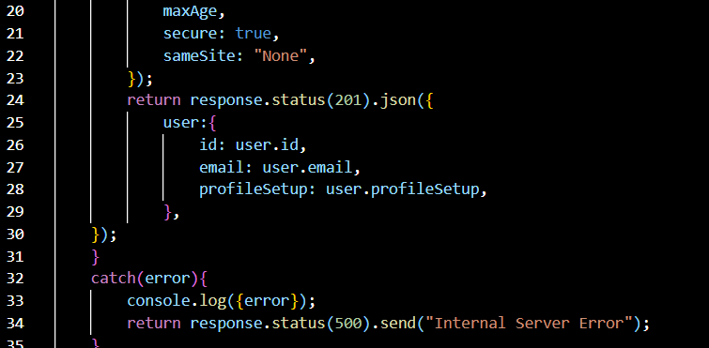
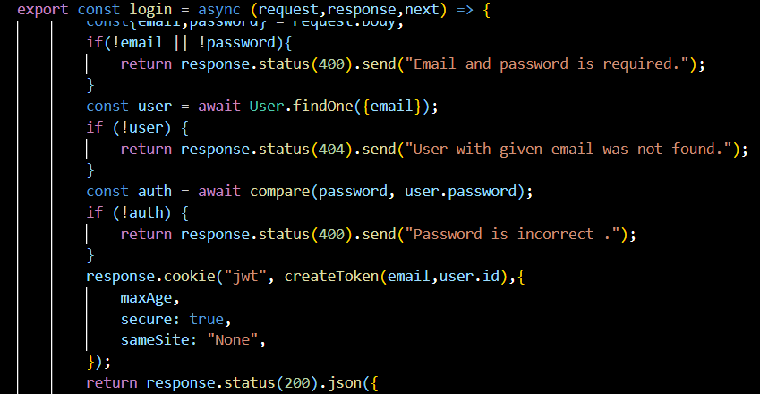

Slide 26
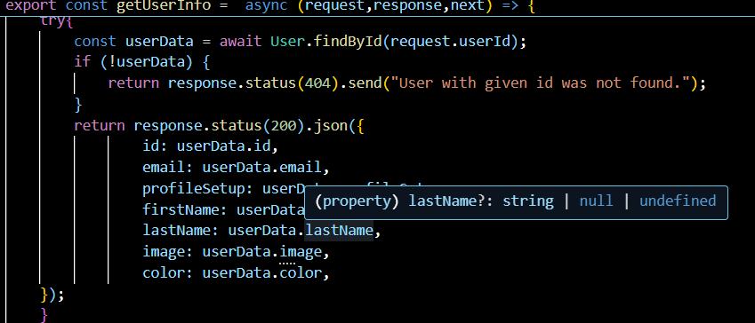
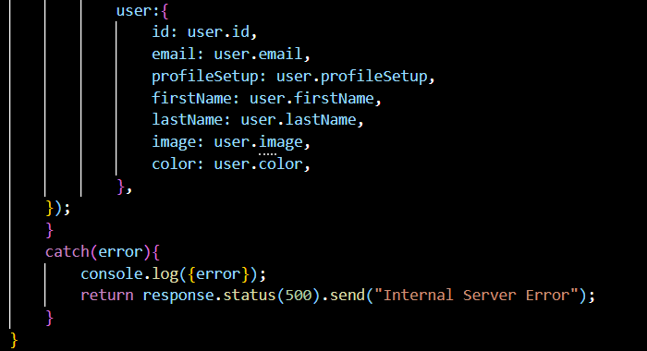

Slide 27
1. Imports
request and response are the Express objects used for handling incoming HTTP requests and sending responses.
User is the model for interacting with the user data in the database.
jwt is used for generating JSON Web Tokens for session management.
compare from bcrypt is used to check if a provided password matches a hashed password stored in the database.
2. maxAge
This variable sets the expiration time for the JWT. It is set to 3 days (in milliseconds).
3. createToken function
This helper function is responsible for creating a JWT that will be sent back to the client to keep the user authenticated. The token includes the user's email and userId as payload, and it will expire after maxAge milliseconds.

Slide 28
4. signup function
Handles user registration:
Request Validation: It checks if email and password are provided in the request body. If either is missing, it sends a 400 status with an error message.
User Creation: It uses the User.create() method to create a new user in the database with the provided email and password.
Token Creation & Cookie Setup: After successfully creating the user, the function generates a JWT with the createToken() function and sends it as a cookie in the response. The cookie is configured to be secure and use the SameSite attribute set to None, which is typically used for cross-site cookies.
Response: Sends a response with status 201 (Created) and returns the user details (excluding sensitive data like password).
5. login function
Handles user login:
Request Validation: It checks if the email and password are provided in the request body. If either is missing, it sends a 400 status with an error message.
User Lookup: It looks for a user with the given email in the database. If no user is found, it responds with a 404 status.
Password Validation: It uses bcrypt.compare() to check if the provided password matches the stored hashed password in the database. If the passwords don't match, it returns a 400 status with an error message.
Token Creation & Cookie Setup: If the email and password are correct, it creates a JWT and sends it as a cookie in the response.
Response: Sends a 200 status with the user’s information (including extra user details like firstName, lastName, image, etc.).

Slide 29
6. getUserInfo function
Fetches the authenticated user's details:
User Lookup: It uses request.userId (presumably set earlier in middleware after decoding the JWT) to find the user in the database using User.findById(). If no user is found, it responds with a 404 status.
Response: Sends a 200 status with the user's information (excluding sensitive data like the password).
JWT Authentication Workflow (Implied but not directly shown):
When a user successfully logs in or signs up, a JWT is created and sent as a cookie.
The getUserInfo function seems to assume that the user is authenticated, and it uses the userId from the decoded JWT to fetch and return the user’s information.
Error Handling
In case of errors, 500 (Internal Server Error) is returned with a generic message and the error is logged to the console.
The program returns specific error messages for missing email/password or incorrect credentials in the signup and login functions.
Secure Cookie Configuration

Slide 30
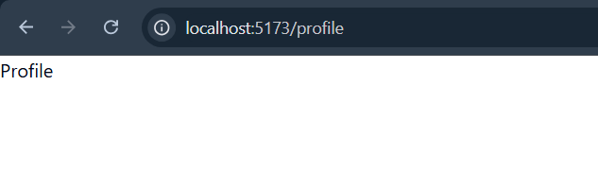
OUTPUT
Now the profile has created successfully

Slide 31
THANK YOU

